Slide 1
Daily performance PITFALLS
Łukasz Pyrzyk

Slide 2

Łukasz pyrzyk
Works remotely from Wroclaw
Co-founder of Dotnetos
Senior Full Stack Cloud Developer at Sonova/JCommerce​
Tweets as @lukaszpyrzyk

Slide 3
Agenda
Assuming performance improvement by looking at code which may look faster
Decompiling our code with Sharplab.io to understand how optimizer can predict our ideas
Story of the releasing product in debug mode
Relying on the debug code behaviours and object state
Surprising behaviours of tiered compilation
Steaming network data with ASP.NET
Optimizing code with ArrayPool and ETW events
Simple, but valuable optimization of the CosmosDB which come from documentation
Pitfalls of optimizing code without taking a wider perspective on the problem
@lukaszpyrzyk

Slide 4


Slide 5
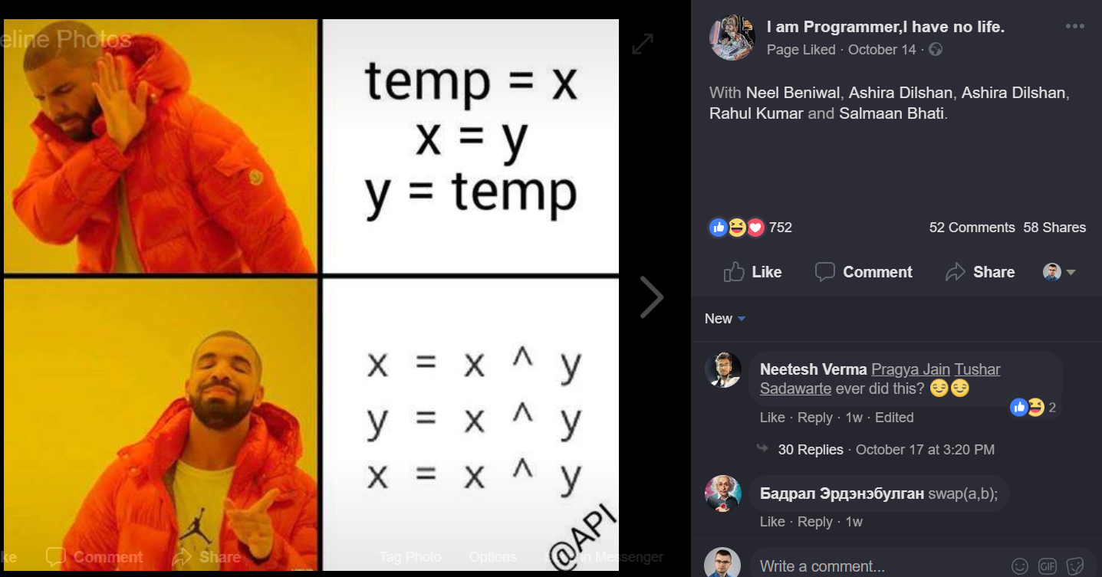

Slide 6
issue #1 Assuming performance improvement
@lukaszpyrzyk

Slide 7

public void XOR(ref int x, ref int y)
{
x = x ^ y;
y = x ^ y;
x = x ^ y;
}
No temp int variable
int is 4 bytes, so it saves 4 bytes
CPU has XOR operation, so it’s 1:1 mapping, so it’s should be fast
@lukaszpyrzyk

Slide 8
00007ffc`d7459170 XOR(Int32 ByRef, Int32 ByRef)
IL_0000: ldarg.1, IL_0001: ldarg.1
IL_0002: ldind.i4, IL_0003: ldarg.2
IL_0004: ldind.i4,
IL_0005: xor
IL_0006: stind.i4
00007ffc`d7459170 418b00 mov eax,dword ptr [r8]
00007ffc`d7459173 3102 xor dword ptr [rdx],eax
IL_0007: ldarg.2, IL_0008: ldarg.1
IL_0009: ldind.i4, IL_000a: ldarg.2
IL_000b: ldind.i4
IL_000c: xor
IL_000d: stind.i4
00007ffc`d7459175 8b02 mov eax,dword ptr [rdx]
00007ffc`d7459177 413100 xor dword ptr [r8],eax
IL_000e: ldarg.1, IL_000f: ldarg.1
IL_0010: ldind.i4, IL_0011: ldarg.2
IL_0012: ldind.i4
IL_0013: xor
IL_0014: stind.i4
00007ffc`d745917a 418b00 mov eax,dword ptr [r8]
00007ffc`d745917d 3102 xor dword ptr [rdx],eax
IL_0015: ret
00007ffc`d745917f c3 ret
@lukaszpyrzyk

Slide 9
00007ffc`d7459170 TempVariable(Int32 ByRef, Int32 ByRef)
IL_0000: ldarg.1
IL_0001: ldind.i4
IL_0002: stloc.0
00007ffc`d7459170 8b02 mov eax,dword ptr [rdx]
IL_0003: ldarg.1
IL_0004: ldarg.2
IL_0005: ldind.i4
IL_0006: stind.i4
00007ffc`d7459172 418b08 mov ecx,dword ptr [r8]
00007ffc`d7459175 890a mov dword ptr [rdx],ecx
IL_0007: ldarg.2
IL_0008: ldloc.0
IL_0009: stind.i4
00007ffc`d7459177 418900 mov dword ptr [r8],eax
IL_000a: ret
00007ffc`d745917a c3 ret
@lukaszpyrzyk

Slide 10
XOR
00007ff9`b7092140 418b00 mov eax,dword ptr [r8]
00007ff9`b7092143 3102 xor dword ptr [rdx],eax
00007ff9`b7092145 8b02 mov eax,dword ptr [rdx]
00007ff9`b7092147 413100 xor dword ptr [r8],eax
00007ff9`b709214a 418b00 mov eax,dword ptr [r8]
00007ff9`b709214d 3102 xor dword ptr [rdx],eax
00007ff9`b709214f c3 ret
TempVariable
00007ff9`b70b2140 8b02 mov eax,dword ptr [rdx]
00007ff9`b70b2142 418b08 mov ecx,dword ptr [r8]
00007ff9`b70b2145 890a mov dword ptr [rdx],ecx
00007ff9`b70b2147 418900 mov dword ptr [r8],eax
00007ff9`b70b214a c3 ret
@lukaszpyrzyk

Slide 11
Method | Mean | Error | StdDev | Median
XOR | 2.8275 ns | 0.0615 ns | 0.0575 ns | 2.8419 ns
BenchmarkDotNet=v0.11.5, OS=Windows 10.0.16299.1146 (1709/FallCreatorsUpdate/Redstone3)
Intel Core i5-7200U CPU 2.50GHz (Kaby Lake), 1 CPU, 4 logical and 2 physical cores
Frequency=2648437 Hz, Resolution=377.5812 ns, Timer=TSC
@lukaszpyrzyk

Slide 12
Method | Mean | Error | StdDev | Median
XOR | 2.8275 ns | 0.0615 ns | 0.0575 ns | 2.8419 ns
TempVariable | 0.0114 ns | 0.0131 ns | 0.0123 ns | 0.0000 ns
The method duration is indistinguishable from the empty method duration
Requires Benchmarkdotnet v0.11.2+
@lukaszpyrzyk

Slide 13
public void AddAndSubtract(ref int x, ref int y)
{
x = x + y;
y = x - y;
x = x - y;
}
@lukaszpyrzyk

Slide 14
Method | Mean | Error | StdDev | Median
XOR | 2.8275 ns | 0.0615 ns | 0.0575 ns | 2.8419 ns
TempVariable | 0.0114 ns | 0.0131 ns | 0.0123 ns | 0.0000 ns
AddAndSubtract | 2.8454 ns | 0.0691 ns | 0.0646 ns | 2.8798 ns
BenchmarkDotNet=v0.11.5, OS=Windows 10.0.16299.1146 (1709/FallCreatorsUpdate/Redstone3)
Intel Core i5-7200U CPU 2.50GHz (Kaby Lake), 1 CPU, 4 logical and 2 physical cores
Frequency=2648437 Hz, Resolution=377.5812 ns, Timer=TSC
@lukaszpyrzyk

Slide 15
Method | Runtime | Mean | Error | StdDev | Median
TempVariable | Clr | 0.0022 ns | 0.0067 ns | 0.0062 ns | 0.0000 ns
AddAndSubtract | Clr | 3.0518 ns | 0.0767 ns | 0.0641 ns | 3.0383 ns
XOR | Clr | 2.9713 ns | 0.0636 ns | 0.0594 ns | 2.9579 ns
TempVariable | Core | 0.0199 ns | 0.0264 ns | 0.0418 ns | 0.0000 ns
AddAndSubtract | Core | 3.0355 ns | 0.0953 ns | 0.1135 ns | 3.0258 ns
XOR | Core | 2.8102 ns | 0.0778 ns | 0.0728 ns | 2.7733 ns
TempVariable | Mono | 0.4762 ns | 0.0937 ns | 0.2704 ns | 0.3619 ns
AddAndSubtract | Mono | 2.9212 ns | 0.1042 ns | 0.1115 ns | 2.8869 ns
XOR | Mono | 2.8912 ns | 0.0686 ns | 0.0573 ns | 2.8840 ns

Slide 16

@lukaszpyrzyk

Slide 17
public void XOR()
{
int x = 4096, y = 8192;
x = x ^ y;
y = x ^ y;
x = x ^ y;
Console.WriteLine(x);
Console.WriteLine(y);
}
@lukaszpyrzyk

Slide 18
public void Temp()
{
int x = 4096, y = 8192;
int temp = x;
x = y;
y = temp;
Console.WriteLine(x);
Console.WriteLine(y);
}
@lukaszpyrzyk

Slide 19
Benchmarking….
@lukaszpyrzyk

Slide 20
It is the same!
@lukaszpyrzyk

Slide 21
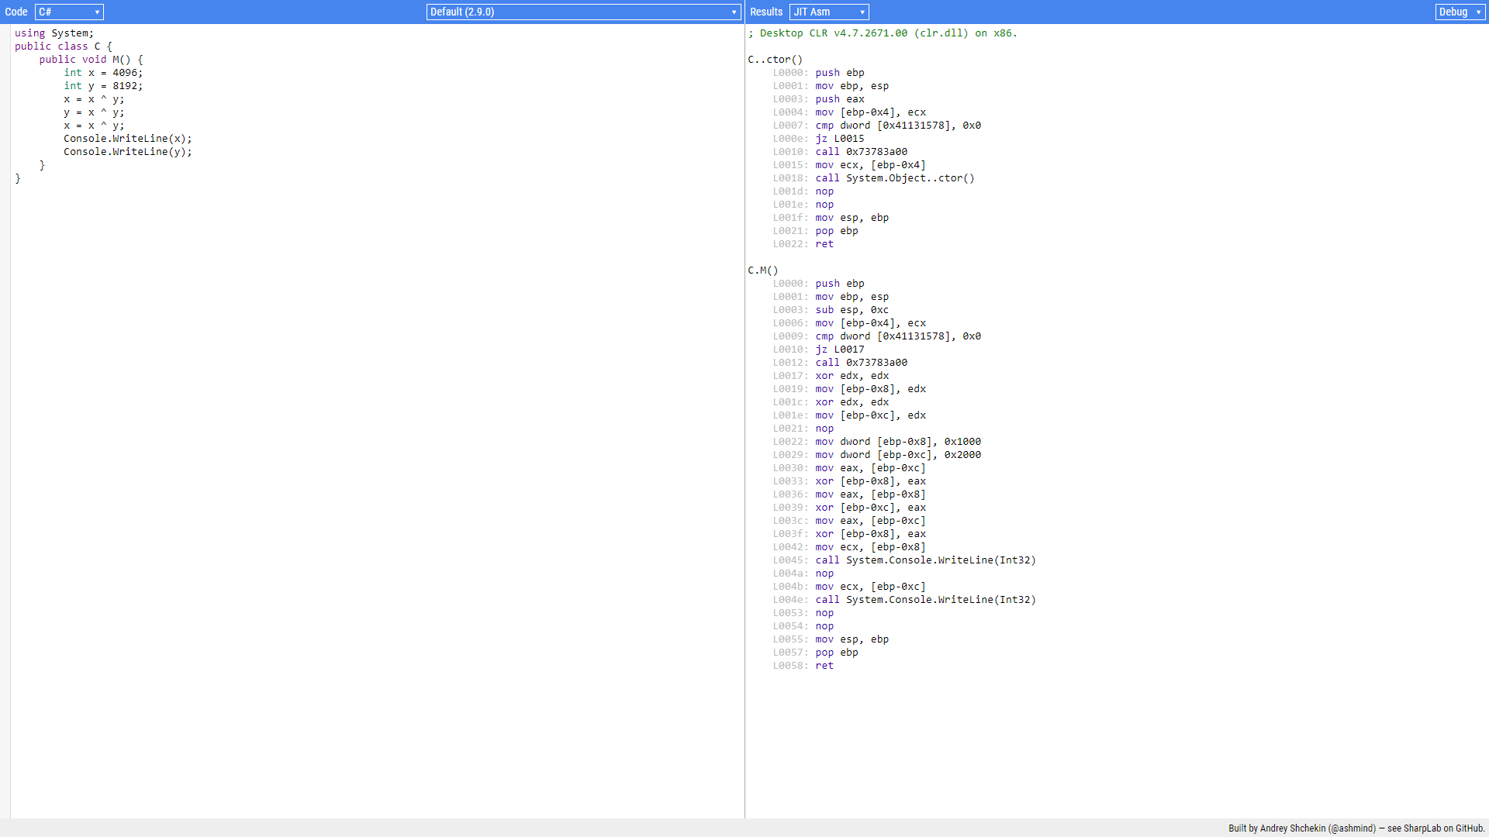
Debug assembly 30 lines

Slide 22
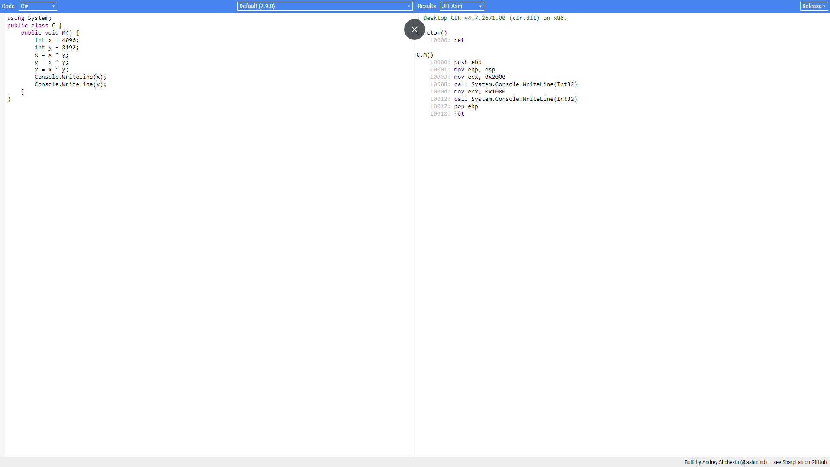
Release assembly 8 lines
Notes:
in real life and big applications, it’s not always possible to use BenchmarkDotNet. In this case, Debug build can be a source of huge problems in the performance analysis.

Slide 23
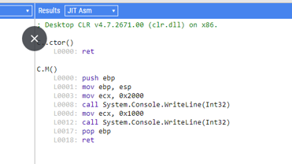

Slide 24
Issue #2 Releasing product in debug mode
@lukaszpyrzyk

Slide 25

@lukaszpyrzyk

Slide 26
YAML
YAMLDOTNET
@lukaszpyrzyk

Slide 27
Previous yamldotnet benchmarks
foreach(var test in tests)
{
Console.Write("{0}\t{1}\t", adapterName, test.GetType().Name);
var graph = test.Graph;
RunTest(serializer, graph); // warmup
if (!Stopwatch.IsHighResolution) Console.Error.WriteLine("Stopwatch is not high resolution!");
var timer = Stopwatch.StartNew();
for (var i = 0; i < iterations; ++i)
RunTest(serializer, graph);
var duration = timer.Elapsed;
Console.WriteLine("{0}", duration.TotalMilliseconds / iterations);
}
@lukaszpyrzyk

Slide 28
Attemp with benchmarkdotnet
[MemoryDiagnoser]
public class ReceiptTest
{
private readonly Receipt _receipt = new Receipt();
private readonly StringWriter _buffer = new StringWriter();
private readonly ISerializer _serializer = new SerializerBuilder()
.WithNamingConvention(new CamelCaseNamingConvention())
.Build();
[Benchmark]
public void Serialize()
{
_serializer.Serialize(_buffer, _receipt.Graph);
}
}
@lukaszpyrzyk

Slide 29
dotnet run –c Release
// Validating benchmarks:
Assembly YamlDotNet.PerformanceTests.vlatest which defines benchmarks references non-optimized YamlDotNet
- If you own this dependency, please, build it in RELEASE.
- If you don't, you can create custom config with DontFailOnError to disable our custom policy and allow this benchmark to run.
@lukaszpyrzyk

Slide 30
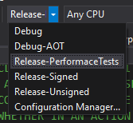
problem
New csproj format doesn’t have the same behaviour as the old one. Configurations like Release-* don’t inherit from Release configuration.
@lukaszpyrzyk

Slide 31
fix
<PropertyGroup Condition="'$(Configuration)' == 'Release-Signed' Or '$(Configuration)' == 'Release-Unsigned' ">
<DefineConstants>$(DefineConstants);RELEASE;TRACE</DefineConstants>
<DebugSymbols>false</DebugSymbols>
<DebugType>portable</DebugType>
<Optimize>true</Optimize>
</PropertyGroup>
@lukaszpyrzyk

Slide 32
fix
-----------------------------------------------------------------------------------
| | Mean | Error | StdDev | Gen0 | Gen1 | Allocated |
-----------------------------------------------------------------------------------
| v1.2.1 | 128.7 us | 1.285 us | 1.202 us | 5.8594 | 0.2441 | 23.66 KB |
| v2.2.0 | 240.6 us | 3.467 us | 3.243 us | 18.0664 | 0.4883 | 60.03 KB |
| v2.3.0 | 307.9 us | 6.112 us | 10.21 us | 20.0195 | 0.4883 | 67.32 KB |
| v3.8.0 | 292.2 us | 4.225 us | 3.952 us | 21.4844 | 0.4883 | 70.82 KB |
| v4.0.0 | 283.2 us | 3.075 us | 2.876 us | 22.9492 | 0.4883 | 74.26 KB |
| v5.2.1 | 539.5 us | 5.710 us | 5.062 us | 8.7891 | 0.9766 | 30.82 KB |
| vlatest | 145.8 us | 1.671 us | 1.563 us | 8.3008 | 0.4883 | 30.7 KB |
----------------------------------------------------------------------------------
@lukaszpyrzyk

Slide 33
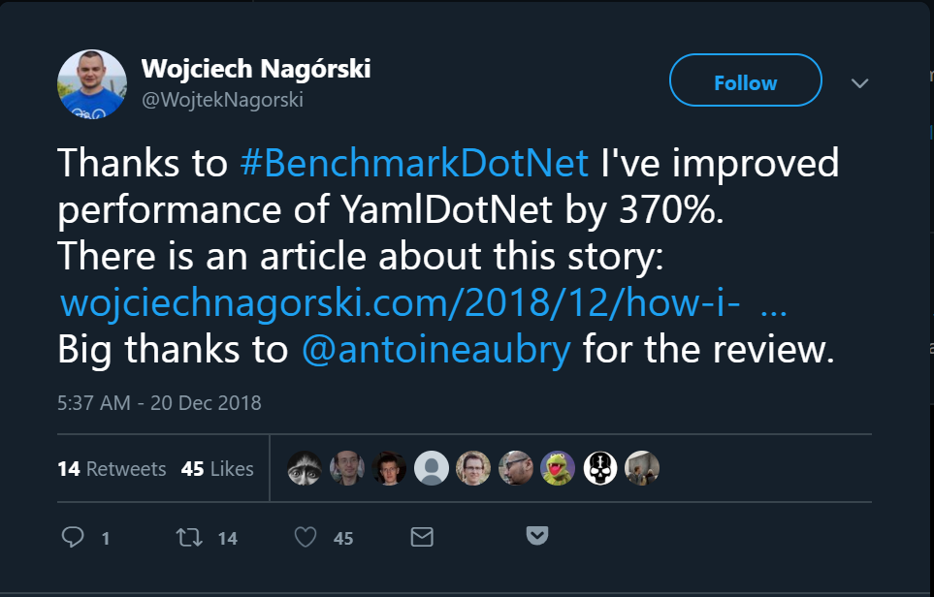
@lukaszpyrzyk

Slide 34
issue #3 Buffering responses
@lukaszpyrzyk

Slide 35
Buffering a file
Github
blob
User
https://github.com/dotnet/corefx/archive/v2.2.0-preview3.zip
@lukaszpyrzyk

Slide 36
Buffering a file
Github
blob
Server
User
http://dotnet.microsoft.com/download/
@lukaszpyrzyk

Slide 37
Buffering a file
public async Task<IActionResult> WithBuffering()
{
var request = new HttpRequestMessage(HttpMethod.Get, "dotnet/corefx/archive/v2.2.0-preview3.zip");
var response = await _client.Client.SendAsync(request);
var stream = await response.Content.ReadAsStreamAsync();
var contentType = response.Content.Headers.ContentType.MediaType;
return new FileStreamResult(stream, contentType);
}
@lukaszpyrzyk

Slide 38
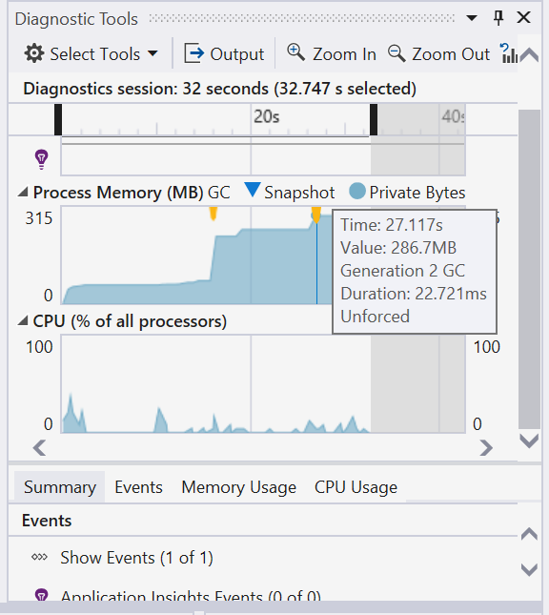
@lukaszpyrzyk

Slide 39
Buffering a file
public async Task<IActionResult> WithoutBuffering()
{
var request = new HttpRequestMessage(HttpMethod.Get, "dotnet/corefx/archive/v2.2.0-preview3.zip");
var response = await _client.Client.SendAsync(request, HttpCompletionOption.ResponseHeadersRead);
var stream = await response.Content.ReadAsStreamAsync();
var contentType = response.Content.Headers.ContentType.MediaType;
return new FileStreamResult(stream, contentType);
}
@lukaszpyrzyk

Slide 40
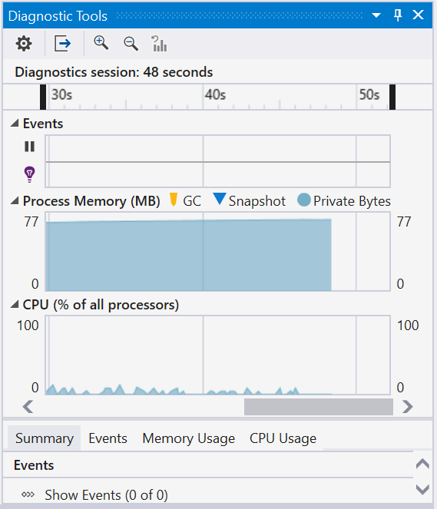
@lukaszpyrzyk

Slide 41
Buffering a file
public async Task<Stream> Stream()
{
var request = new HttpRequestMessage(HttpMethod.Get, "dotnet/corefx/archive/v2.2.0-preview3.zip");
var response = await _client.Client.GetStreamAsync(request.RequestUri);
return response;
}
@lukaszpyrzyk

Slide 42
Issue #4 Relying on the object state
@lukaszpyrzyk

Slide 43
Code
static void Main(string[] args)
{
var timer = new Timer(x => Console.WriteLine(DateTime.UtcNow), null, 0, 100);
Console.WriteLine("Timer started?");
GC.Collect();
Console.Read();
}
@lukaszpyrzyk

Slide 44
debug
dotnet run -c Debug
14/10/2019 18:43:22
Timer started?
14/10/2019 18:43:22
14/10/2019 18:43:22
14/10/2019 18:43:22
[…]
@lukaszpyrzyk

Slide 45
release
dotnet run -c Release
Timer started?
14/10/2019 18:48:56
@lukaszpyrzyk

Slide 46
Eager root collection it is a Just-in-time compiler optimization which makes local references irrelevant after their last usage

Slide 47
keep alive
static void Main(string[] args)
{
var timer = new Timer(x => Console.WriteLine(DateTime.UtcNow), null, 0, 100);
Console.WriteLine("Timer started?");
GC.Collect();
Console.Read();
GC.KeepAlive(timer);
}
@lukaszpyrzyk

Slide 48
Calling dispose
static void Main(string[] args)
{
var timer = new Timer(x => Console.WriteLine(DateTime.UtcNow), null, 0, 100);
Console.WriteLine("Timer started?");
GC.Collect();
Console.Read();
timer.Dispose();
}
@lukaszpyrzyk

Slide 49
Calling dispose
static void Main(string[] args)
{
using (var timer = new Timer(x => Console.WriteLine(DateTime.UtcNow), null, 0, 100))
{
Console.WriteLine("Timer started?");
GC.Collect();
Console.Read();
}
}
@lukaszpyrzyk

Slide 50
Calling dispose
C# 8.0

Slide 51
Calling dispose
static void Main(string[] args)
{
using var timer = new Timer(x => Console.WriteLine(DateTime.UtcNow), null, 0, 100);
Console.WriteLine("Timer started?");
GC.Collect();
Console.Read();
}
@lukaszpyrzyk

Slide 52
Calling dispose
[NullableContext(1)]
[Nullable(0)]
public sealed class Timer : MarshalByRefObject, IAsyncDisposable, Idisposable { /// <summary>Releases all resources used by the current instance of <see cref="T:System.Threading.Timer" />.</summary>
/// <returns>A <see cref="T:System.Threading.Tasks.ValueTask" /> that completes when all work associated with the timer has ceased.</returns>
public ValueTask DisposeAsync();
}
@lukaszpyrzyk

Slide 53
Calling dispose
static async Task Main(string[] args)
{
await using var timer = new Timer(x => Console.WriteLine(DateTime.UtcNow), null, 0, 100);
Console.WriteLine("Timer started?");
GC.Collect();
Console.Read();
}
@lukaszpyrzyk

Slide 54


Slide 55
Code
static void Main(string[] args)
{
var timer = new Timer(x => Console.WriteLine(DateTime.UtcNow), null, 0, 100);
Console.WriteLine("Timer started?");
GC.Collect();
Console.Read();
}
@lukaszpyrzyk

Slide 56
release
dotnet run -c Release Timer started?
16/10/2019 16:36:51
16/10/2019 16:36:51
16/10/2019 16:36:51
16/10/2019 16:36:51
16/10/2019 16:36:51
16/10/2019 16:36:51
16/10/2019 16:36:51
[..]
@lukaszpyrzyk

Slide 57
What?

Slide 58
Issue #4 forgetting about tiered compilation

Slide 59
.NET Core version | Tiered compilation
2.0 | None
2.1 | Optional
3.0 | Default
@lukaszpyrzyk

Slide 60
release
<Project Sdk="Microsoft.NET.Sdk">
<PropertyGroup>
<OutputType>Exe</OutputType>
<TargetFramework>netcoreapp2.1</TargetFramework>
<TieredCompilation>true</TieredCompilation>
</PropertyGroup>
</Project>
@lukaszpyrzyk

Slide 61
release
<Project Sdk="Microsoft.NET.Sdk">
<PropertyGroup>
<OutputType>Exe</OutputType>
<TargetFramework>netcoreapp3.0</TargetFramework>
</PropertyGroup>
</Project>
@lukaszpyrzyk

Slide 62


Slide 63
tiered compilation can influence the profiling and benchmarking results. It can change results of samples from books or blog posts
@lukaszpyrzyk

Slide 64
If your intention is to optimize the method as quickly as possible, you can use attribute the method with MethodImpl(MethodImplOptions.AggressiveOptimization)], which skips tier 0. However, in the future the attribute may not generate fully optimized code, but it may try to optimize method as quickly as possible.

Slide 65
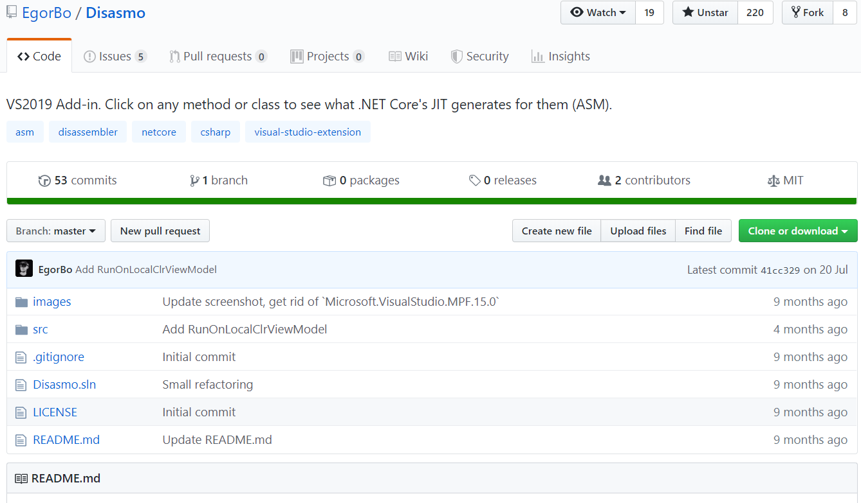

Slide 66
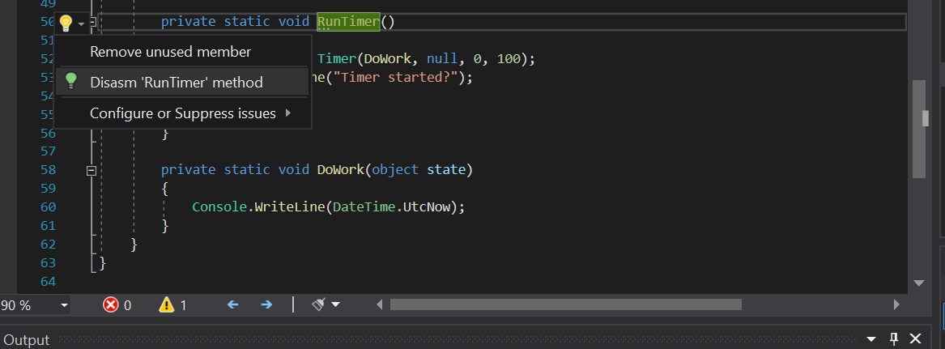

Slide 67
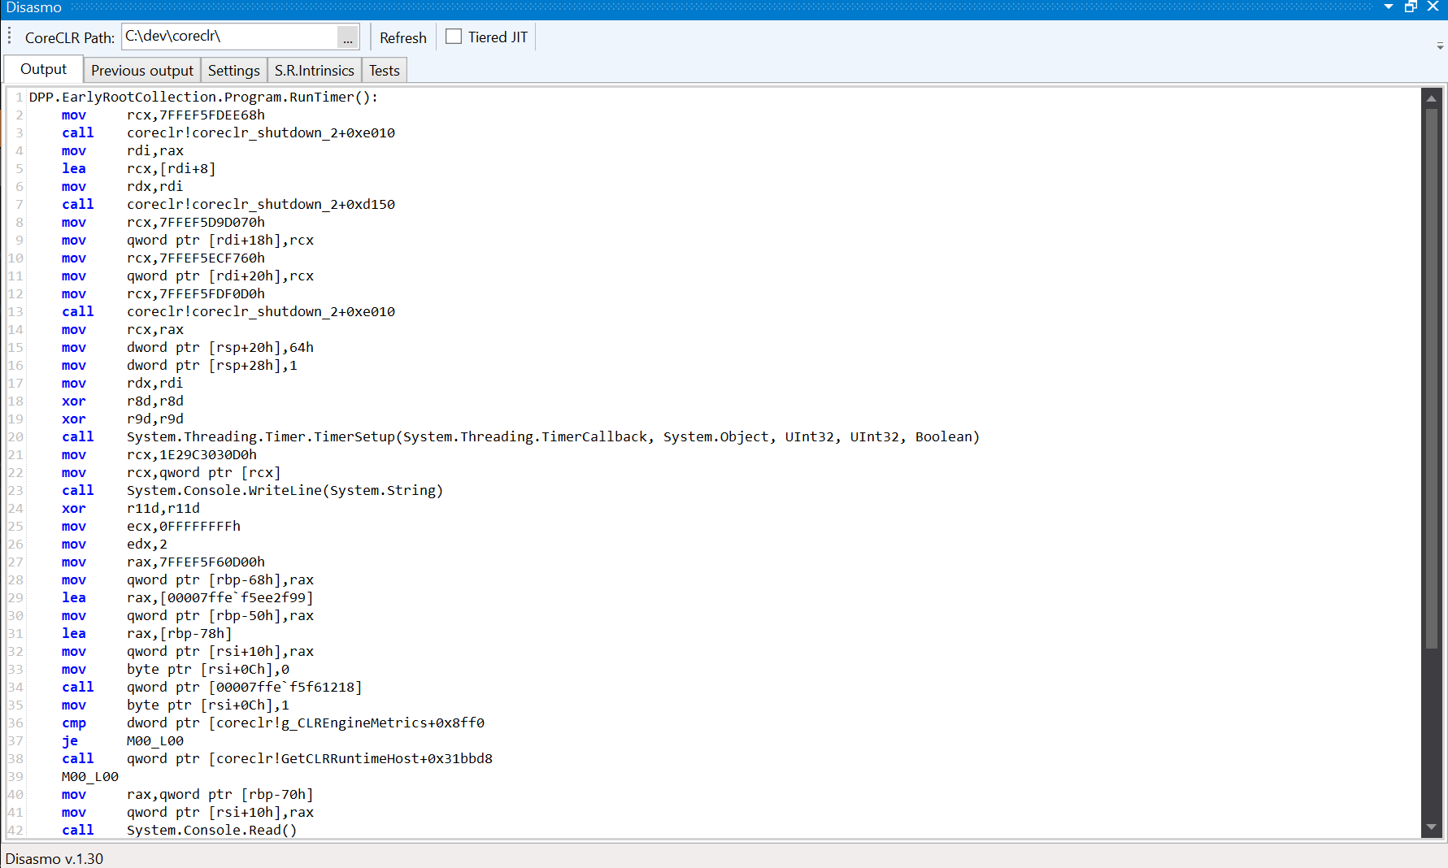
212 bytes of code

Slide 68
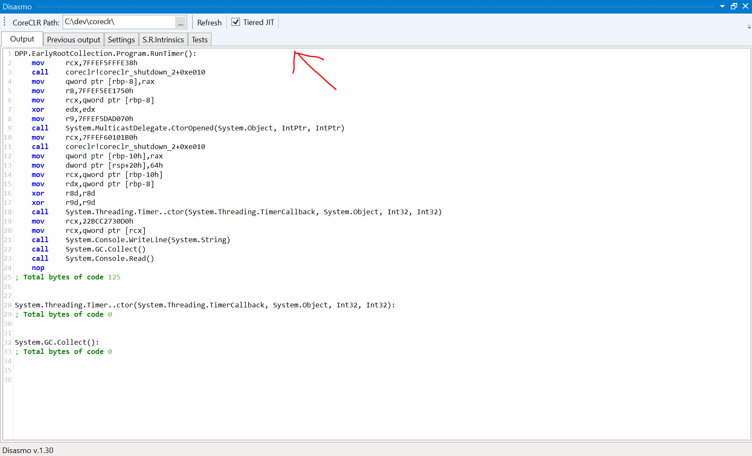
125 bytes of code

Slide 69
issue #5 Not using ETW events

Slide 70
private static async Task Default()
{
var buffer = new byte[8 * 1024];
for (int i = 0; i < Iterations; i++)
{
foreach (var file in Directory.EnumerateFiles("images"))
{
var fileInfo = new FileInfo(file);
var array = new byte[fileInfo.Length];
await using var stream = File.OpenRead(file);
await ReadStreamToArray(fileInfo, stream, buffer, array);
}
}
}
@lukaszpyrzyk

Slide 71
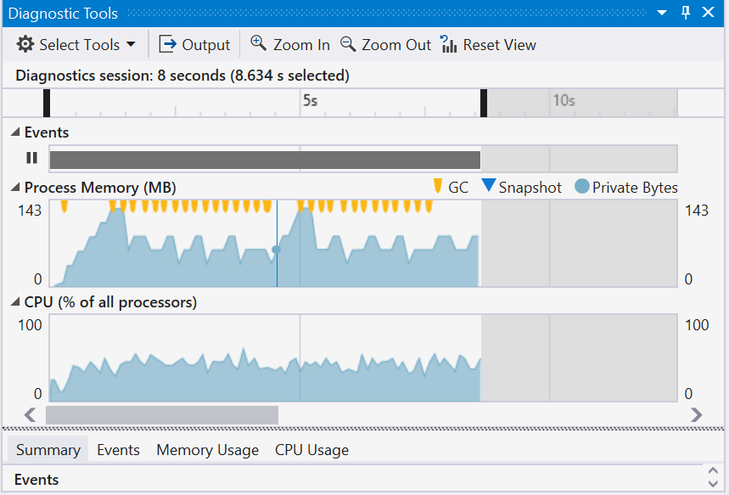

Slide 72
CommandLine: "C:\dev\DPF\Src\DPF.ArrayPool\bin\Release\netcoreapp3.0\DPF.ArrayPool.exe"
Runtime Version: V 4.0.30319.0 (built on 13/09/2019 01:02:04)
CLR Startup Flags: None
Total CPU Time: 11,368 msec
Total GC CPU Time: 19 msec
Total Allocs : 1,263.242 MB
GC CPU MSec/MB Alloc : 0.015 MSec/MB
Total GC Pause: 20.5 msec
% Time paused for Garbage Collection: 0.3%
% CPU Time spent Garbage Collecting: 0.2%
Max GC Heap Size: 145.235 MB
Peak Process Working Set: 170.570 MB
Peak Virtual Memory Usage: 2,199,714.988 MB
@lukaszpyrzyk

Slide 73
ArrayPool<byte>.Shared

Slide 74
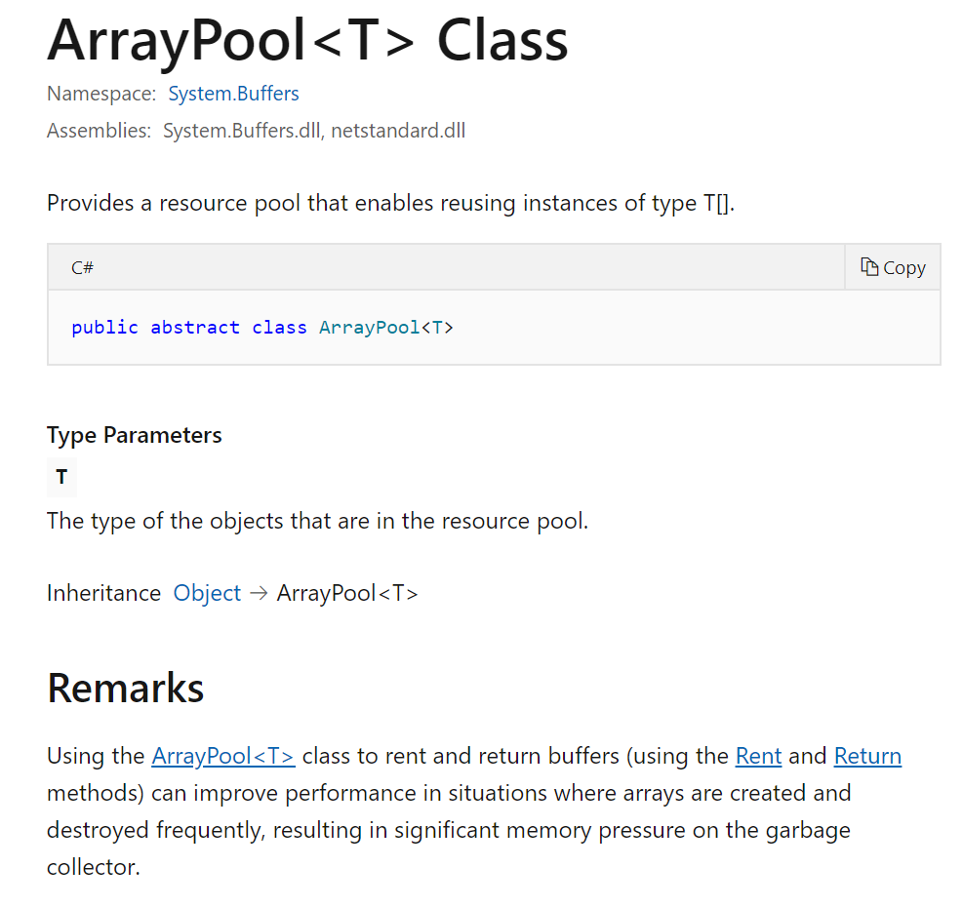

Slide 75
var arrayPool = ArrayPool<byte>.Shared; var buffer = arrayPool.Rent(8 * 1024);
try
{
for (int i = 0; i < Iterations; i++)
{
foreach (var file in Directory.EnumerateFiles("images"))
{
var fileInfo = new FileInfo(file);
var array = arrayPool.Rent(Convert.ToInt32(fileInfo.Length));
try
{
await using var stream = File.OpenRead(file);
await ReadStreamToArray(fileInfo, stream, buffer, array);
}
finally
{
arrayPool.Return(array);
}
}
}
}
finally
{
arrayPool.Return(buffer);
}
@lukaszpyrzyk

Slide 76
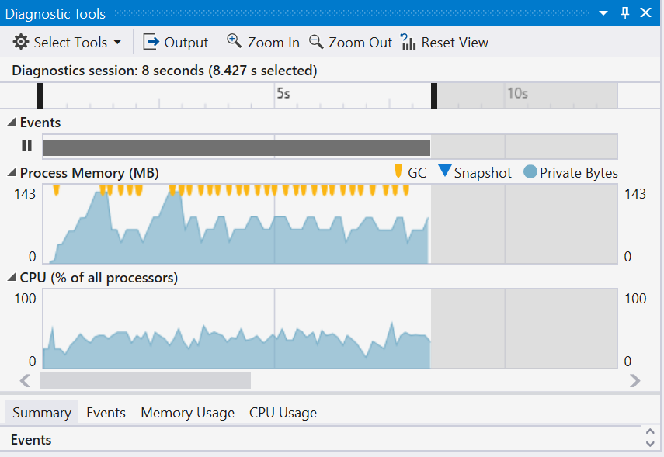

Slide 77
CommandLine: "C:\dev\DPF\Src\DPF.ArrayPool\bin\Release\netcoreapp3.0\DPF.ArrayPool.exe"
Runtime Version: V 4.0.30319.0 (built on 13/09/2019 01:02:04)
CLR Startup Flags: None
Total CPU Time: 12,527 msec
Total GC CPU Time: 12 msec
Total Allocs : 1,014.148 MB
GC CPU MSec/MB Alloc : 0.012 MSec/MB
Total GC Pause: 25.1 msec
% Time paused for Garbage Collection: 0.3%
% CPU Time spent Garbage Collecting: 0.1%
Max GC Heap Size: 146.111 MB
Peak Process Working Set: 158.175 MB
Peak Virtual Memory Usage: 2,199,715.676 MB
@lukaszpyrzyk

Slide 78
Remarks
Using the ArrayPool<T> class to rent and return buffers (using the Rent and Return methods) can improve performance in situations where arrays are created and destroyed frequently, resulting in significant memory pressure on the garbage collector.
@lukaszpyrzyk

Slide 79
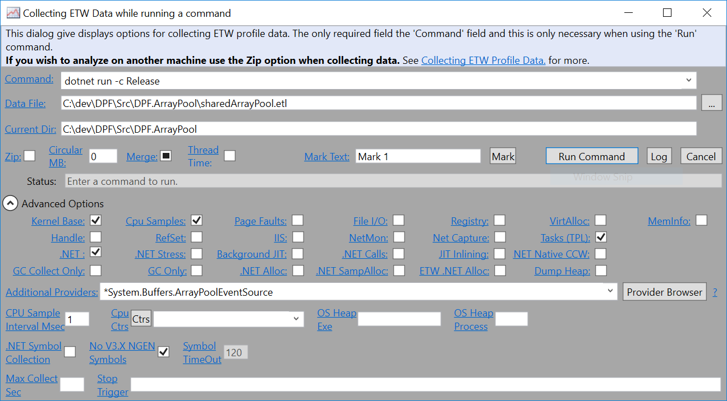

Slide 80
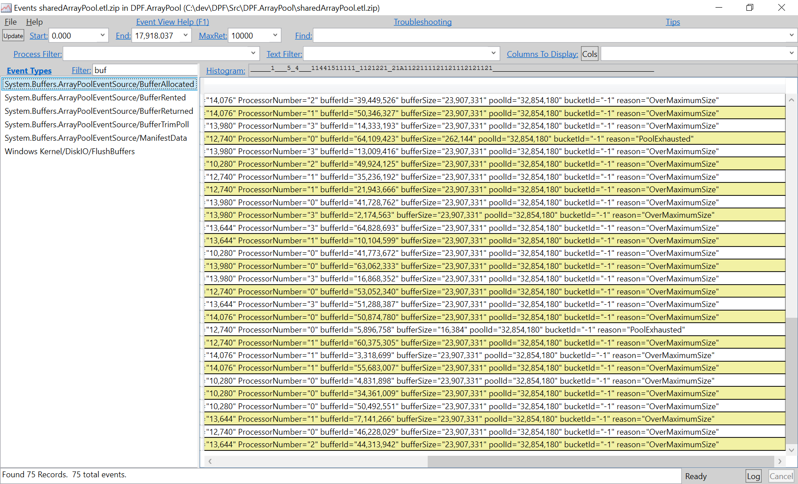

Slide 82
ArrayPool<byte>.Create

Slide 83
var biggestFile = Directory.GetFiles("images").Select(x => new FileInfo(x)).Select(x => x.Length).Max();
var arrayPool = ArrayPool<byte>.Create(maxArrayLength: Convert.ToInt32(biggestFile), maxArraysPerBucket: 1);
var buffer = arrayPool.Rent(8 * 1024);
try
{
for (int i = 0; i < Iterations; i++)
{
foreach (var file in Directory.EnumerateFiles("images"))
{
var fileInfo = new FileInfo(file);
var array = arrayPool.Rent(Convert.ToInt32(fileInfo.Length));
try
{
await using var stream = File.OpenRead(file);
await ReadStreamToArray(fileInfo, stream, buffer, array);
}
finally
{
arrayPool.Return(array);
}
}
}
}
finally
{
arrayPool.Return(buffer);
}
@lukaszpyrzyk

Slide 84
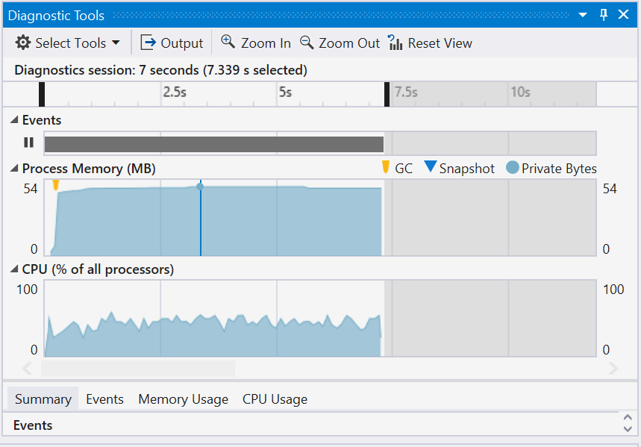

Slide 85
CommandLine: "C:\dev\DPF\Src\DPF.ArrayPool\bin\Release\netcoreapp3.0\DPF.ArrayPool.exe"
Runtime Version: V 4.0.30319.0 (built on 13/09/2019 01:02:04)
CLR Startup Flags: None
Total CPU Time: 11,358 msec
Total GC CPU Time: 8 msec
Total Allocs : 58.261 MB
GC CPU MSec/MB Alloc : 0.137 MSec/MB
Total GC Pause: 11.3 msec
% Time paused for Garbage Collection: 0.2%
% CPU Time spent Garbage Collecting: 0.1%
Max GC Heap Size: 37.899 MB
Peak Process Working Set: 51.962 MB
Peak Virtual Memory Usage: 2,199,574.643 MB
@lukaszpyrzyk

Slide 86
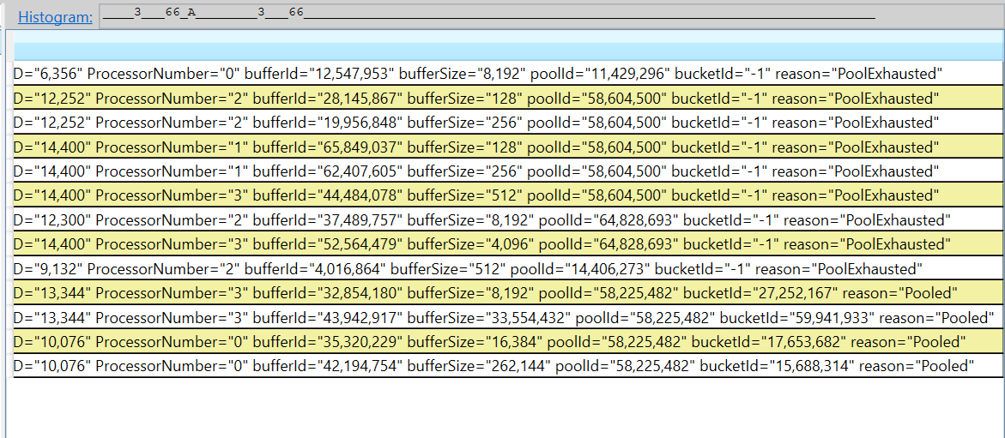

Slide 87
 | Allocated bytes | Max GC Heap Size
New arrays | 1,263.242 MB | 145.235 MB
Shared ArrayPool | 1,014.148 MB | 146.111 MB
Custom ArrayPool<byte> | 58.261 MB | 37.899 MB
@lukaszpyrzyk

Slide 88
TIP arraypool.shared allocates memory if it needs to rent array bigger than 2^20 (1024 * 1024) elements
@lukaszpyrzyk

Slide 89
Issue #6 relying on the library and cross platform features
@lukaszpyrzyk

Slide 90
public class TelemetryEntry
{
public DateTimeOffset Timestamp { get; set; }
public int UserId { get; set; }
}
@lukaszpyrzyk

Slide 91
[Route("[controller]")]
[ApiController]
public class TelemetryController : Controller
{
[HttpPut]
public async Task<IActionResult> Insert([FromServices] DataStorageService db)
{
var entry = CreateEntry();
await db.Insert(entry);
return NoContent();
}
}
@lukaszpyrzyk

Slide 92

@lukaszpyrzyk

Slide 93
public class SlowDataStorageService
{
private readonly DataStorageServiceOptions _options; private readonly DocumentClient _client;
public SlowDataStorageService(DataStorageServiceOptions options)
{
_options = options;
_client = new DocumentClient(options.Endpoint, options.ApiKey);
_client.CreateDatabaseIfNotExistsAsync(new Database { Id = options.DatabaseName }).GetAwaiter().GetResult();
_client.CreateDocumentCollectionIfNotExistsAsync(
UriFactory.CreateDatabaseUri(options.DatabaseName),
new DocumentCollection { Id = options.CollectionName })
.GetAwaiter().GetResult();
}
}
GetAwaiter().GetResult()
@lukaszpyrzyk

Slide 94
public async Task Insert(TelemetryEntry telemetryEntry)
{
var collectionUri = UriFactory.CreateDocumentCollectionUri(_options.DatabaseName, _options.CollectionName);
await _client.CreateDocumentAsync(collectionUri, telemetryEntry);
}
@lukaszpyrzyk

Slide 95
public void ConfigureServices(IServiceCollection services)
{
var dbOptions = GetOptions();
services.AddSingleton(dbOptions);
services.AddTransient<DataStorageService>();
}
@lukaszpyrzyk

Slide 96
Testing – no docs
Running 30s test @ http://localhost:5000/telemetry/insert/slow
1 threads and 1 connections
Thread Stats Avg Stdev Max +/- Stdev
Latency 876.89ms 45.82ms 993.87ms 76.47%
Req/Sec 0.88 0.33 1.00 88.24%
34 requests in 30.07s, 2.69KB read
Requests/sec: 1.13
Transfer/sec: 91.57B
@lukaszpyrzyk

Slide 97
QUITE SLOW QUITE UGLY
@lukaszpyrzyk

Slide 98
public class AsyncLazy<T> : Lazy<Task<T>>
{
public AsyncLazy(Func<Task<T>> valueFactory) : base(valueFactory)
{
}
}
@lukaszpyrzyk

Slide 99
public class DataStorageService
{
private readonly AsyncLazy<DocumentClient> _clientFactory; private readonly Uri _collectionUri;
public DataStorageService(DataStorageServiceOptions options)
{
_collectionUri = UriFactory.CreateDocumentCollectionUri(options.DatabaseName, options.CollectionName);
_clientFactory = new AsyncLazy<DocumentClient>(async () =>
{
var client = new DocumentClient(options.Endpoint, options.ApiKey);
await InitialDatabase(client, options);
});
}
}
@lukaszpyrzyk

Slide 100
public async Task Insert(TelemetryEntry telemetryEntry)
{
var client = await _clientFactory.Value;
await client.CreateDocumentAsync(_collectionUri, telemetryEntry);
}
@lukaszpyrzyk

Slide 101
public void ConfigureServices(IServiceCollection services)
{
var dbOptions = GetOptions();
services.AddSingleton(dbOptions);
services.AddSingleton<DataStorageService>();
}
@lukaszpyrzyk

Slide 102
Testing - optimizations
@lukaszpyrzyk

Slide 103
_clientFactory = new AsyncLazy<DocumentClient>(async () =>
{
var client = new DocumentClient(options.Endpoint, options.ApiKey, new ConnectionPolicy
{
ConnectionMode = ConnectionMode.Direct,
ConnectionProtocol = Protocol.Tcp
});
await InitialDatabase(client, options);
});
@lukaszpyrzyk

Slide 104
Testing – direct / tcp
@lukaszpyrzyk

Slide 105

The goneEXCEPTION story
Microservices
CosmosDB
Migration to the Direct/TCP connection policy, feature toggle
Thousands of the GoneException saying “The requested resource is no longer available at the server”
We have a bug!!!
Race condition? Dispose? Network down? Firewall?
@lukaszpyrzyk

Slide 106

@lukaszpyrzyk

Slide 107
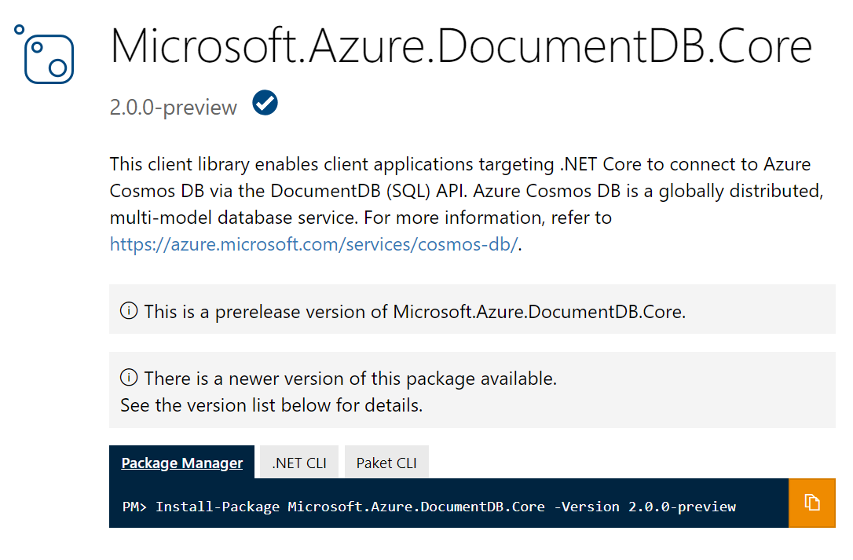
@lukaszpyrzyk

Slide 108
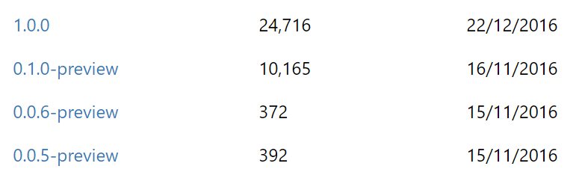
@lukaszpyrzyk

Slide 109
The goneEXCEPTION story
GoneException(“The requested resource is no longer available at the server”)
might be
PlatformNotSupportedException();
@lukaszpyrzyk

Slide 110
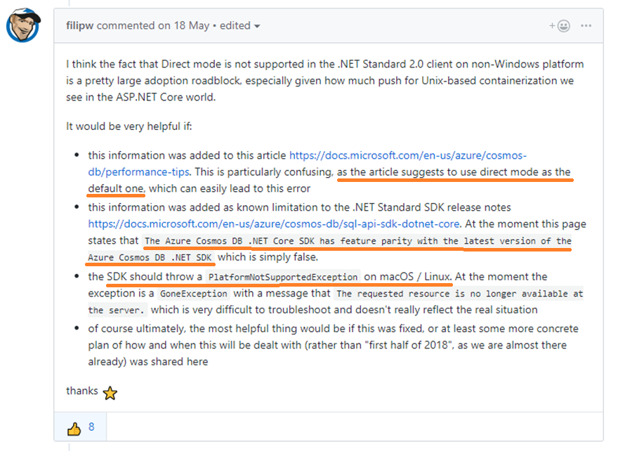
https://github.com/Azure/azure-cosmosdb-dotnet/issues/194
@lukaszpyrzyk

Slide 111
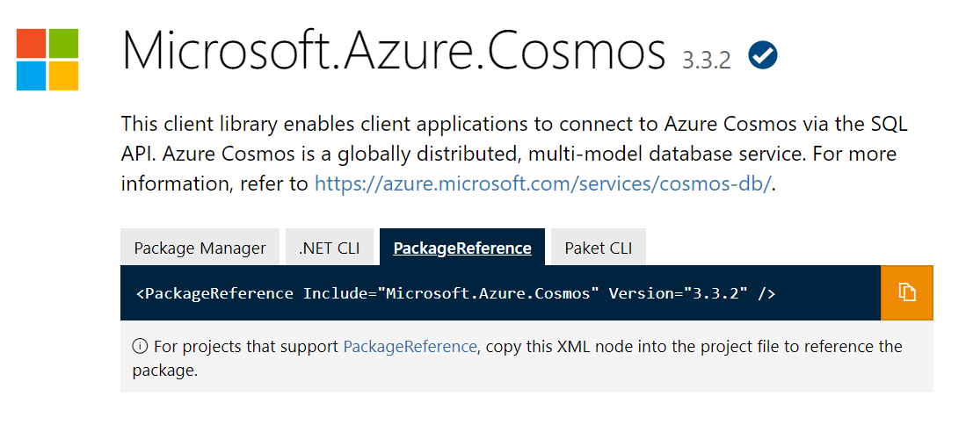
@lukaszpyrzyk

Slide 112
issue #7 Let’s optimize it
@lukaszpyrzyk

Slide 113

The business problem
This is very important for our company
It’s PoC
Please make it ASAP
Performance doesn’t matter
Don’t spend to much time on it
Keep clean and easy to understand for another developers
@lukaszpyrzyk

Slide 114
public ulong SecretAlgorithm(ulong n)
{
if (n == 1 || n == 2) return 1;
return SecretAlgorithm(n - 2) + SecretAlgorithm(n - 1);
}
@lukaszpyrzyk

Slide 115
public ulong Fibonacci(ulong n)
{
if (n == 1 || n == 2) return 1;
return Fibonacci(n - 2) + Fibonacci(n - 1);
}
@lukaszpyrzyk

Slide 116

The business problem
It works
It is simple
@lukaszpyrzyk

Slide 117
The business problem
Make it faster!
@lukaszpyrzyk

Slide 118
The business problem
What kind of optimizations techniques do I know?
@lukaszpyrzyk

Slide 119


Slide 120

THREADS
!!!

Slide 121
public ulong Fibonacci(ulong n)
{
if (n == 1 || n == 2) return 1;
var a = Task.Run(() => Fibonacci(n - 2));
var b = Task.Run(() => Fibonacci(n - 1));
Task.WaitAll(a, b);
return a.Result + b.Result;
}
@lukaszpyrzyk

Slide 122
@lukaszpyrzyk

Slide 123

LESS THREADS

Slide 124
public ulong Fibonacci(ulong n)
{
if (n == 1 || n == 2) return 1;
var a = Task.Run(() => FibonacciImplementation(n - 2));
var b = Task.Run(() => FibonacciImplementation(n - 1));
Task.WaitAll(a, b);
return a.Result + b.Result;
}
private ulong FibonacciImplementation(ulong n)
{
if (n == 1 || n == 2) return 1;
return Recursive(n - 2) + Recursive(n - 1);
}
@lukaszpyrzyk

Slide 125
@lukaszpyrzyk

Slide 126
@lukaszpyrzyk

Slide 127

IF STATEMENT

Slide 128
public ulong Fib(ulong n)
{
if (n == 1 || n == 2) return 1;
const int goldenNumber = 18;
return n < goldenNumber ? Recursive(n) : RecursiveTPLStart(n);
}
@lukaszpyrzyk

Slide 129

Let’s debug it
@lukaszpyrzyk

Slide 130
public static ulong Recursive(ulong n)
{
Console.WriteLine($"Calculating Fibonacci for {n}");
if (n == 1 || n == 2) return 1;
return Recursive(n - 2) + Recursive(n - 1);
}
@lukaszpyrzyk

Slide 131
Fibonacci(5);
Calculating Fibonacci for 5
Calculating Fibonacci for 3
Calculating Fibonacci for 1
Calculating Fibonacci for 2
Calculating Fibonacci for 4
Calculating Fibonacci for 2
Calculating Fibonacci for 3
Calculating Fibonacci for 1
Calculating Fibonacci for 2
@lukaszpyrzyk

Slide 132

Algoritms and data structures
@lukaszpyrzyk

Slide 133
Memoization
It is an optimization technique used primarily to speed up computer programs by storing the results of expensive function calls and returning the cached result when the same inputs occur again
@lukaszpyrzyk

Slide 134
Memoization
public ulong Fibonacci(ulong n)
{
if (n == 1 || n == 2) return 1;
var results = new ulong[n];
results[0] = 1;
results[1] = 1;
return FibWithMemoization(n, results);
}
@lukaszpyrzyk

Slide 135
Memoization
private static ulong FibWithMemoization(ulong n, ulong[] results)
{
var current = n - 1;
var previous = current - 1;
var beforePrevious = previous - 1;
if (results[beforePrevious] == 0)
results[beforePrevious] = FibWithMemoization(previous, results);
if (results[previous] == 0)
results[previous] = FibWithMemoization(current, results);
results[current] = results[beforePrevious] + results[previous];
return results[n - 1];
}
@lukaszpyrzyk

Slide 136
@lukaszpyrzyk

Slide 137
@lukaszpyrzyk

Slide 138

WHAT WE MISSED?
@lukaszpyrzyk

Slide 139
public ulong Fibonacci(ulong n)
{
if (n == 1 || n == 2) return 1;
ulong a = 1, b = 1;
for (ulong i = 2; i < n; i++)
{
ulong temp = a + b;
a = b;
b = temp;
}
return b;
}
@lukaszpyrzyk

Slide 140
@lukaszpyrzyk

Slide 141
@lukaszpyrzyk

Slide 142
TIP before doing optimizations Make sure that current solution still fits
@lukaszpyrzyk

Slide 143
Summary
We should always validate our performance improvements by measurement
Releasing product in debug sounds funny, but there are real cases where by mistake debug code was shipped to the clients
Tiered compilation is new in .NET world and we need get used to it. It is a good idea to disable tierec compilation for profiling and benchmarking or get code warm
Reading documentation and API notes may give you easy performance boost, for example by making CosmosDB client singleton with Direct connection or using HttpCompletionOption
ETW event are a great collection of knowledge about our application, for example about ArrayPool usage
Before doing code optimizations we should understand how it is used

Slide 144
Links
Konrad Kokosa - Pro .NET Memory Management, https://prodotnetmemory.com/
Andrey Akinshin - Pro .NET Benchmarking, https://www.apress.com/gp/book/9781484249406
https://docs.microsoft.com/en-us/azure/cosmos-db/performance-tips
https://docs.microsoft.com/en-us/azure/cosmos-db/sql-api-sql-query-metricshttp://www.tugberkugurlu.com/archive/efficiently-streaming-large-http-responses-with-httpclient
https://github.com/davidfowl/AspNetCoreDiagnosticScenarios
https://wojciechnagorski.com/2018/12/how-i-improved-the-yamldotnet-performance-by-370/
https://github.com/aaubry/YamlDotNet/pull/356
@lukaszpyrzyk

Slide 145

Premium .NET Conference with top class speakers Warsaw, Poland
dotnetos.org

Slide 146
Thank you!
@lukaszpyrzyk
lukasz.pyrzyk@gmail.com https://github.com/lukasz-pyrzyk/DailyPerformancePitfalls

